Slide 1
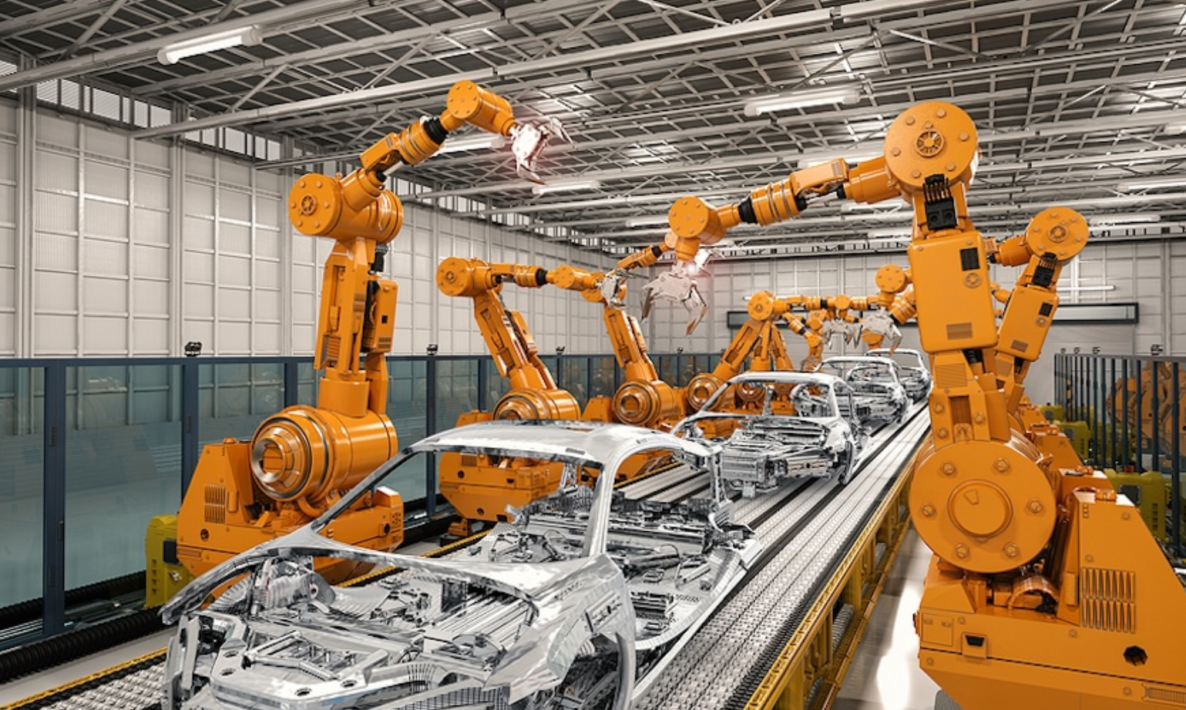


The Uneven Labor Market Impact of Technological Change
---A Macroeconomic Analysis of Industrial Robots
Zhiqi Fang
35954396

Slide 2
The Uneven Labor Market
Effects of Technological Change
A Macroeconomic Analysis of Industrial Robots
Zhiqi Fang
35954396
Focus: productivity, labour demand, unequal employment effects, and macroeconomic policy.

Slide 3


What Is the Phenomenon?
Y=AF(K,N)
01

Slide 5

Thank you for listening

